Slide 1
Assembly Tutorial Guide
ZYC0041
Note: Since international logistics channels prohibit the transportation of products with batteries, the kit does not include any batteries, please prepare batteries in advance or purchase them separately. The model of the battery is: 18650 3.7v 2500mAh-3500mAh

Slide 2
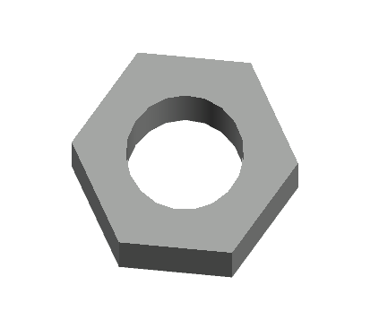
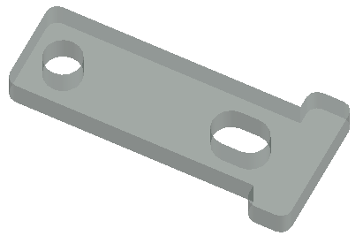
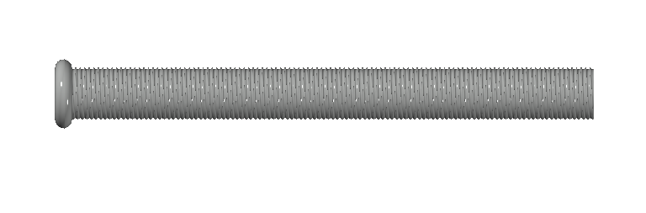
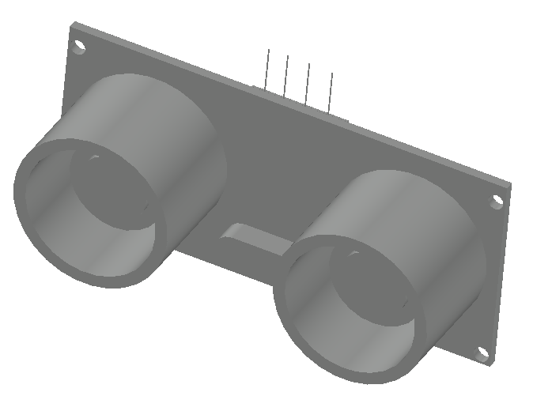
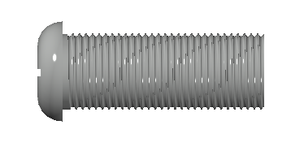

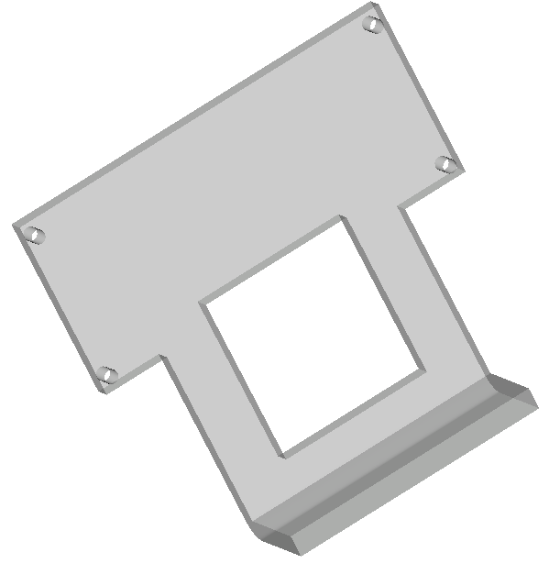
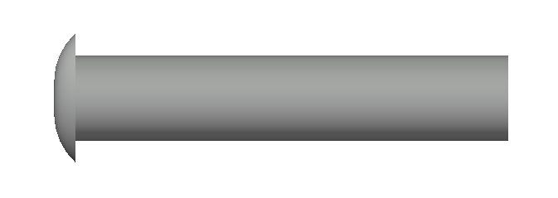
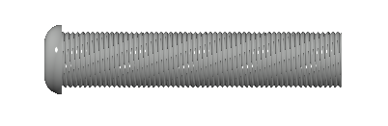
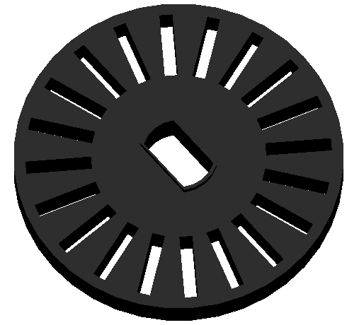

Product list
M3 Nut*17pcs
Motor bracket*8pcs
M3*30 round head screw*8pcs
M2 Nut*3pcs
M1.6 Nut*4pcs
Ultrasonic module*1pc
M3*8 round head screw*33pcs
M2*8 round head screw*2pcs
M3*50 Copper column*3pcs
Ultrasonic bracket*1pc
M1.6*8 Round head screw*4pcs
M3*30 Copper column*8pcs
M3*15+6 Copper column*2pcs
Speed encoder*4pcs

Slide 3
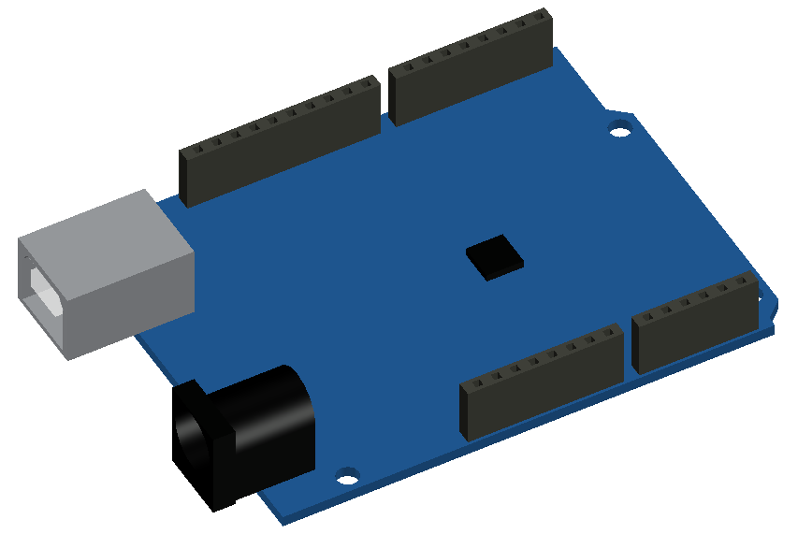
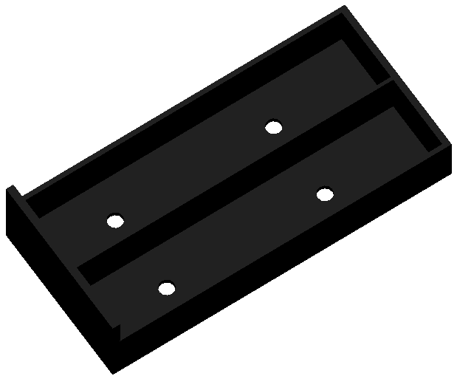
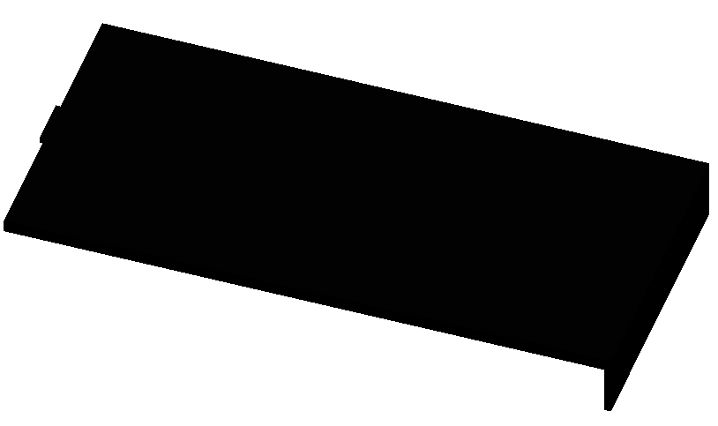
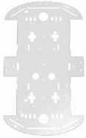
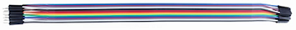
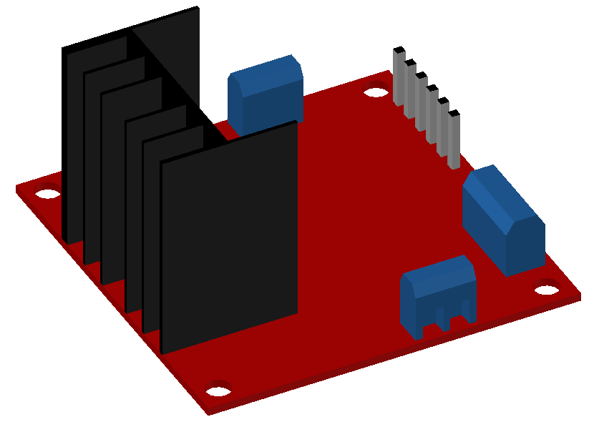
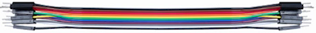
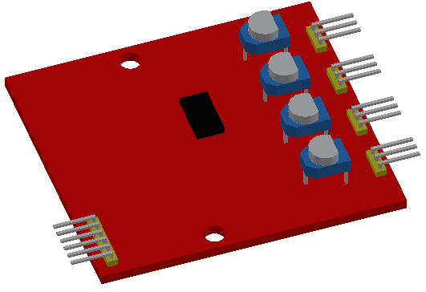
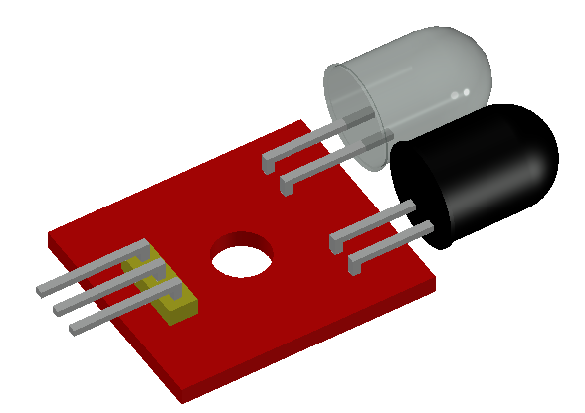
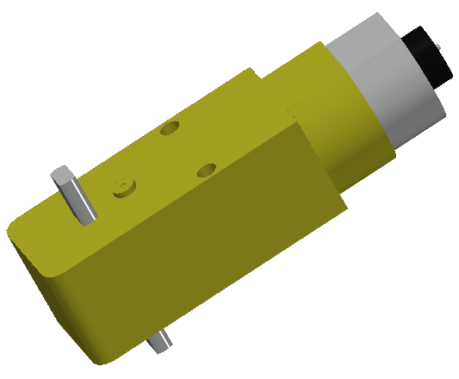
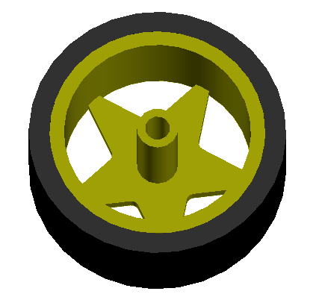
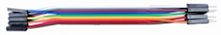
Product list
Male to female Dupont line 2P 30CM*1pc
UNO R3 CH340G main control board with USB cable*1pc
battery pack*1pc
Male to female Dupont line 15P 20CM*1pc
Acrylic transparent base plate*2pcs
Motor drive board*1pc
Male to male Dupont line 8P 20cm*1pc
Male to female Dupont line 4P 10cm*1pc
motor (with wheel welding wire)*4pcs
Four-way tracking module*1pc
Male to male Dupont line 2P 10cm*1pc

Slide 4
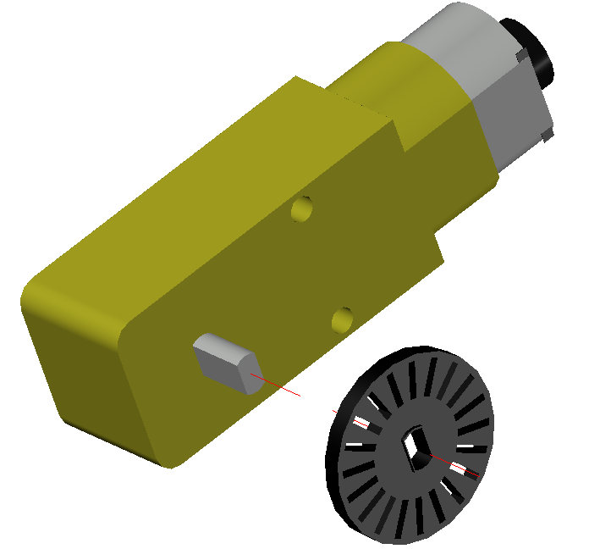
安装马达
Install Speed encoder
① Speed encoder*1pc
② motor*1pc
Align the hole of the speed encoder with the corresponding position on the motor and mount it with force.Install the other three motors in the same way.
Note: the convex side of the speed encoder faces outward.Mounted on the side of the motor with solder joints.

Slide 5
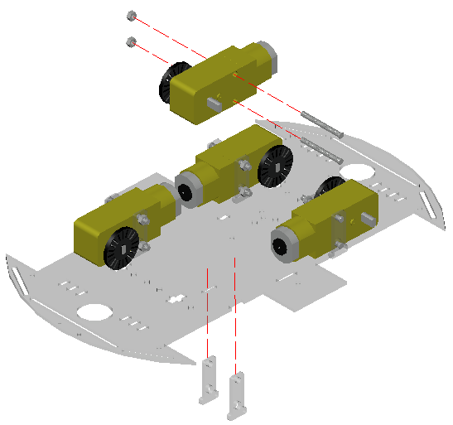
Fixed motor
① M3*30 round head screw*8pcs
② M3 Nut*8pcs
③ Motor bracket*8pcs
④ Acrylic transparent base plate*1pc
First pass the motor bracket through the two holes corresponding to the bottom plate from bottom to top, and then lower the motor from top to bottom, finally take screws through the bracket and the two holes of the motor, lock the nut, and reinforce it with a screwdriver.
（Remove the plate from the set and remove its protective film）
Note: the head and tail of the bottom plate should be distinguished, and pay attention to its line when installing the motor, as shown in the picture above.

Slide 6
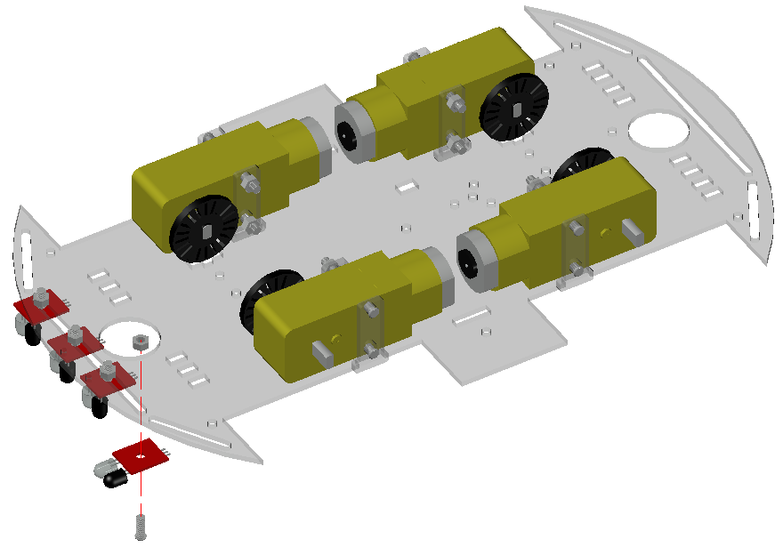
Install the tracking module
① M3 Nut*4pcs
② M3*8 round head screw*4pcs
③ Tracking module*4pcs
Align the hole of the tracking module with the corresponding position on the bottom plate, and then pass the screw from bottom to top. Then lock the nut, and finally reinforce it with a screwdriver.The dupont line can be connected by the way to facilitate the installation behind.
Note: do not install the modules upside down, each module should be separated in the middle, after installing the two receivers face down.

Slide 7
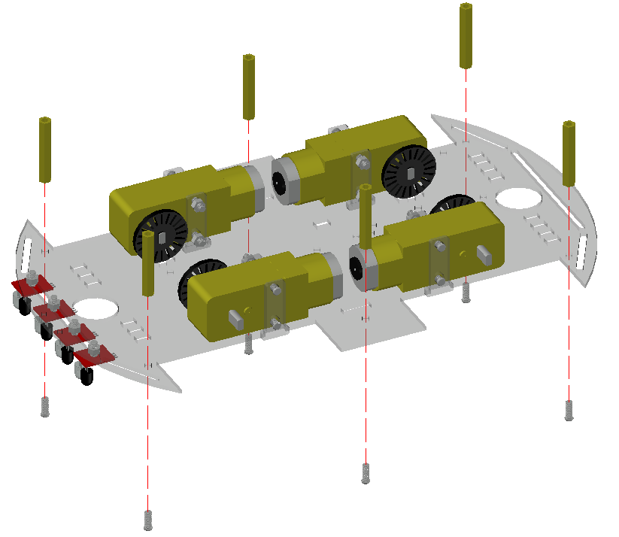
Install copper column on the bottom plate
① M3*30 Copper column*6pcs
② M3*8 round head screw*6pcs
First pass the screw through the corresponding hole, then screw on the copper column, and finally use a screwdriver for reinforcement.
At this point, the installation of the bottom plate has been completed.

Slide 8
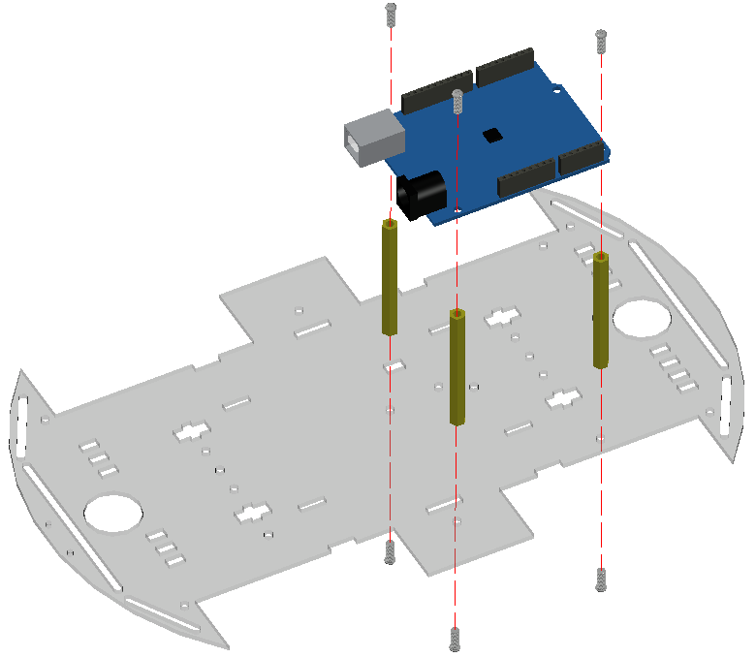
Install the mainboard
① M3*50 Copper column*3pcs
② M3*8 round head screw*6pcs
③ Acrylic transparent base plate*1pc
First screw through the corresponding hole below, and then fix the copper column, and then put the motherboard on the copper column, hole position, lock the screws, and finally with a screwdriver for reinforcement.
Note: Pay attention to the hole position, but also pay attention to the motherboard orientation.

Slide 9
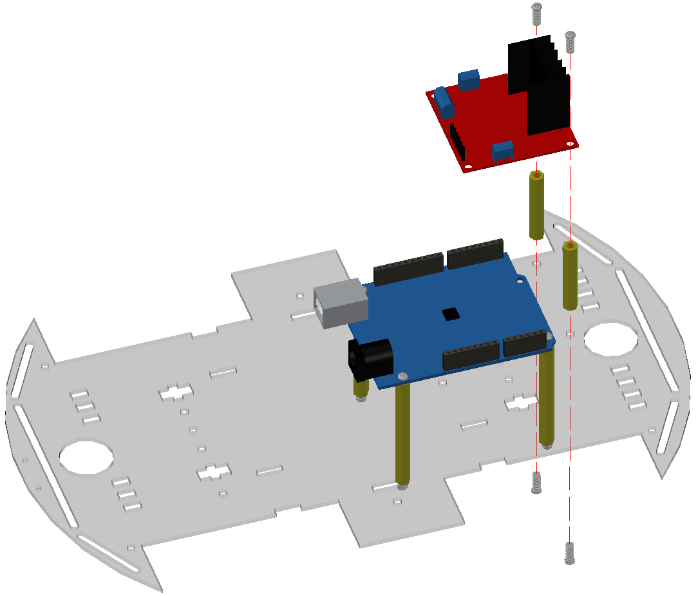
Install motor drive module
① M3*30 Copper column*2pcs
② M3*8 round head screw*4pcs
③ Motor drive board*1pc
First pass the screw through the corresponding hole of the bottom plate from below, screw the copper column, and then align the motor drive board to the corresponding hole with the copper column, lock the screw, and finally reinforce with a screwdriver.
Note: Pay attention to the hole position, and also pay attention to the direction of the motor drive board.

Slide 10
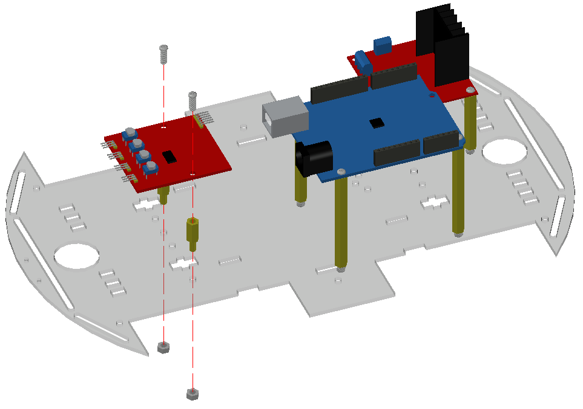
Install four-way tracking control board
① M3*15+6 Copper column*2pcs
② M3*8 round head screw*2pcs
③ four-way tracking control board*1pc
First, pass the M3*15+6 copper column from the base plate through the corresponding hole from the top, lock it with the nut, then put the four-way tracking control board on the copper column, align the hole, then screw on the screw, and finally use the screwdriver for reinforcement.
④Tracking module comes with dupont linefemale to female 3P*4pcs
Note: Note the orientation of the control board.

Slide 11
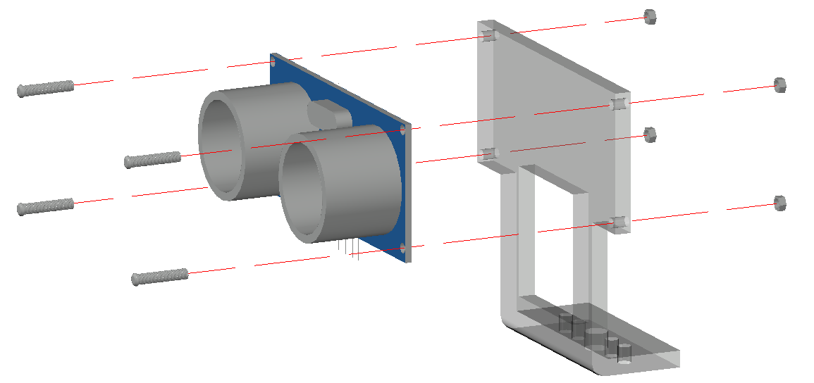
Assembling ultrasonic module
① Ultrasonic module*1pc
② Ultrasonic bracket*1pc
③ M1.6*8 Round head screw*4pcs
The dupont line needs to be inserted into the ultrasonic module first, and then the DuPont line through the hole in the middle of the bracket; Then align the hole of the ultrasonic module with the hole of the bracket, pass the small screw, lock the nut, and finally reinforce it with a screwdriver.
④ M1.6 Nut*4pcs
Note: the parts used in this step are small and need more patience.

Slide 12
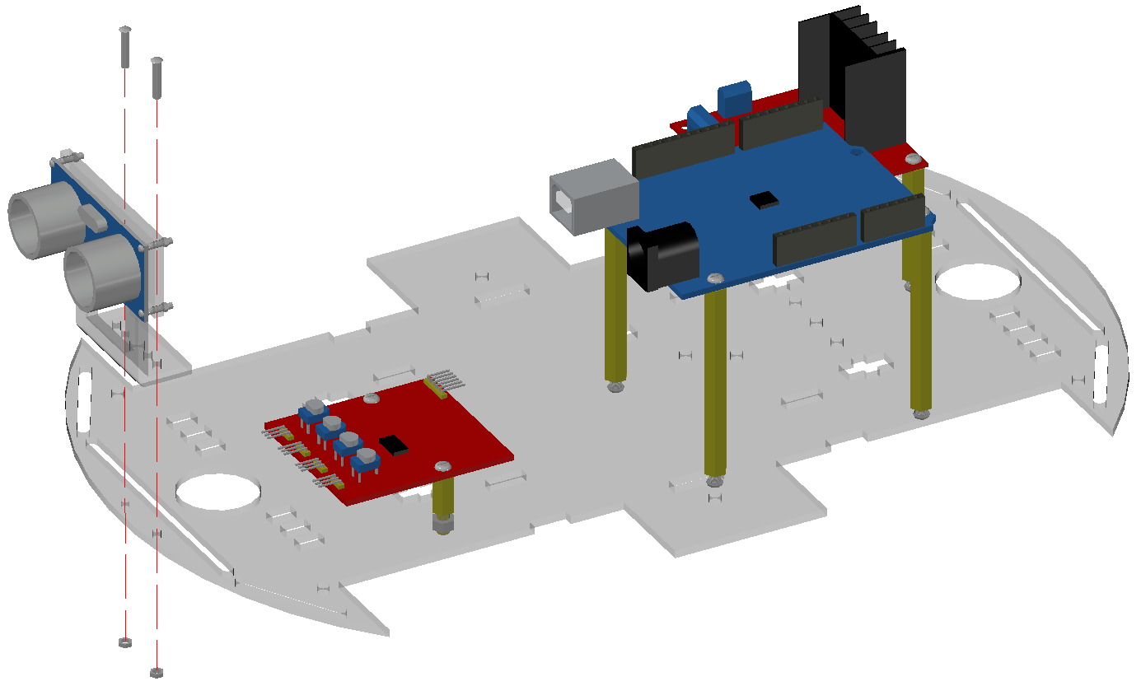
Fixed ultrasonic front
① M2*8 round head screw*2pcs
ultrasonic
② M2 Nut*2pcs
Align the holes on the bracket with the holes on the base plate, pass the screws from the top down, lock the nuts, and reinforce them with a screwdriver.
Note: The parts required for this step are a little small, so patience is required.

Slide 13
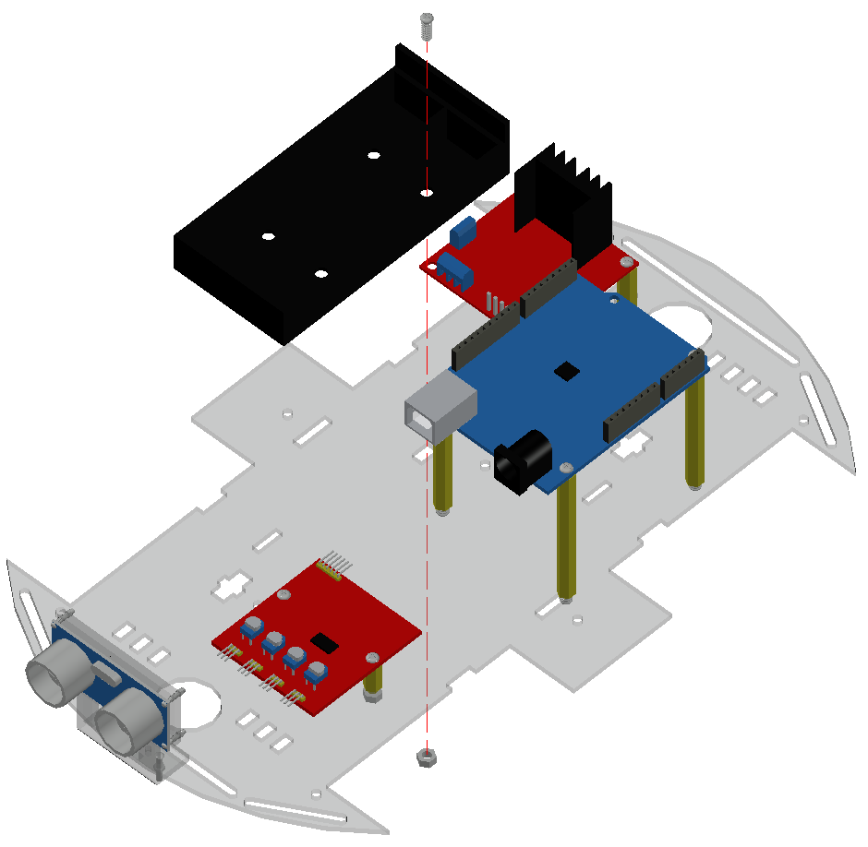
Installing the Battery pack
①M3*8 round head screw*1pc
② M3 Nut*1pc
③ Battery pack*1pc
When you get the battery pack, open the cover first, align the hole in the battery pack with the hole in the board, and then pass the screw from the top down. Finally, align the screw with the nut with one hand, and reinforce it with a screwdriver with the other hand.
Note: After fixing the battery pack, plug the battery cable port into the mainboard.

Slide 14
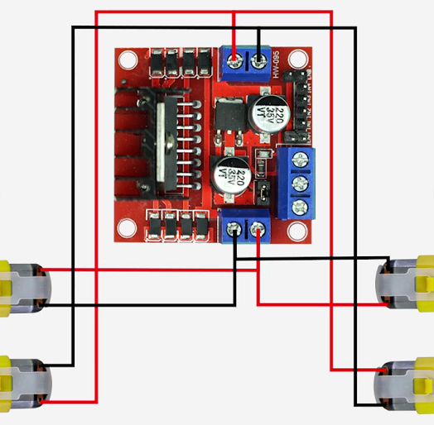
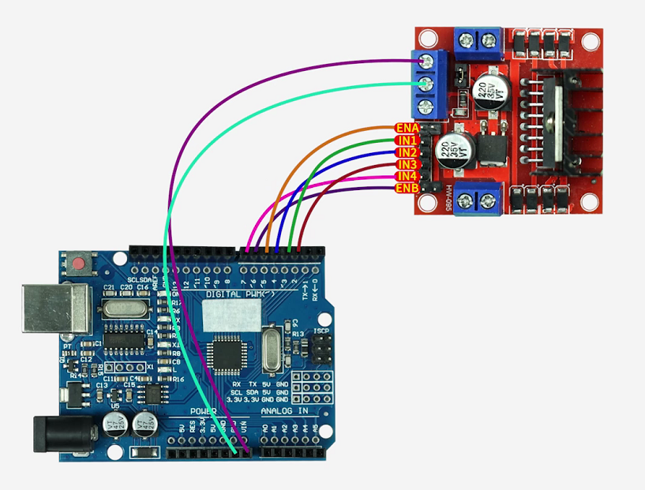
Connect the line
①Motor and motor drive board connection diagram:
Male to female Dupont line 6P 20CM*1pc
Male to male Dupont line 2P 20cm*1pc
(step②)
Male to female Dupont line 4P 10cm*1pc
②motor drive board and main board connection diagram:
Male to female Dupont line 2P 30CM*1pc
(step③)
Male to female Dupont line 4P 20CM*1pc
（step④）
Note: When connecting the motor line, the line can be through the hole near the top bottom plate motor drive board.

Slide 15
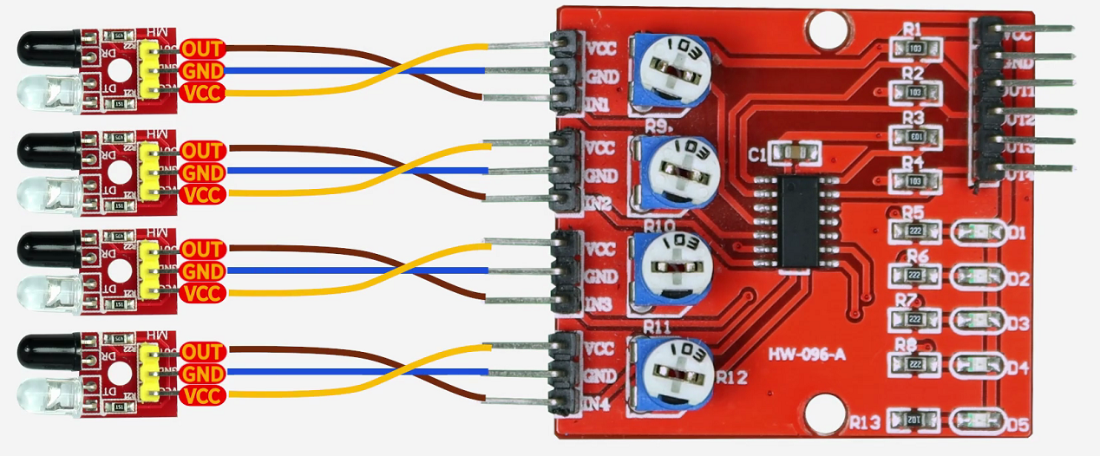
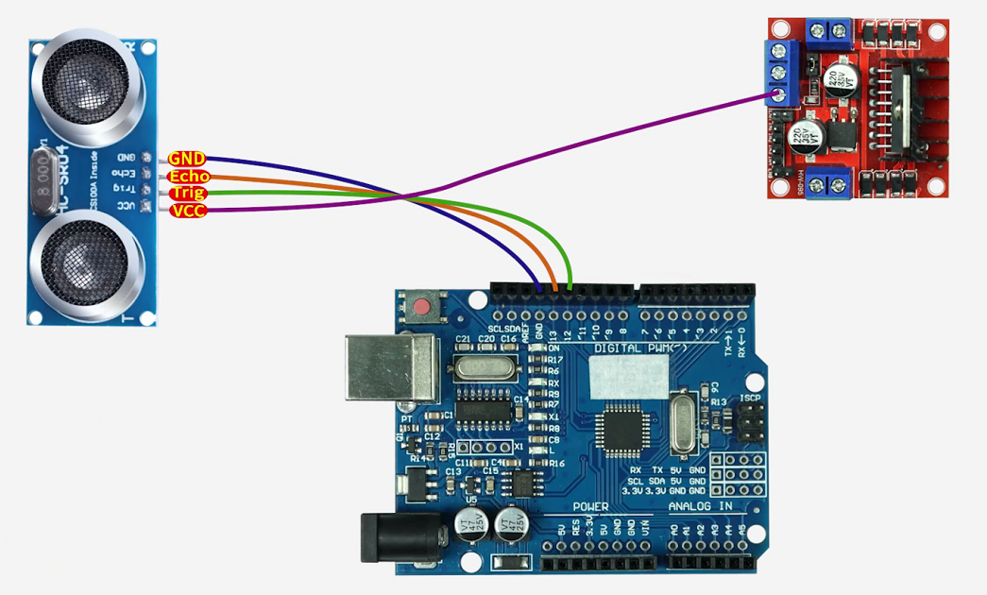
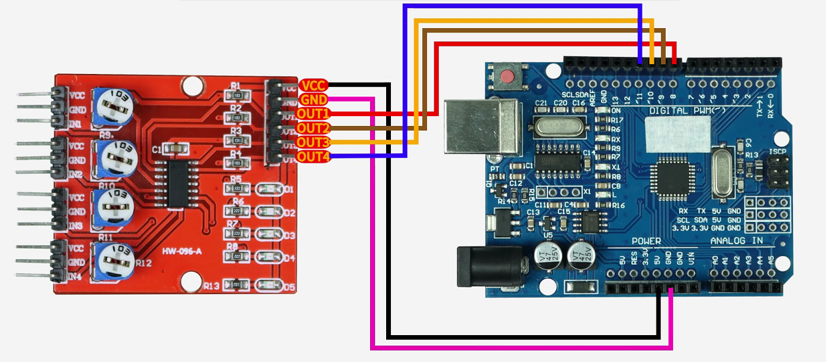
Connect the line
③Tracing module connection diagram:
④ultrasonic module connection diagram:
Note：When connecting the tracking module, you can see the words printed on the module and connect them accordingly.

Slide 16
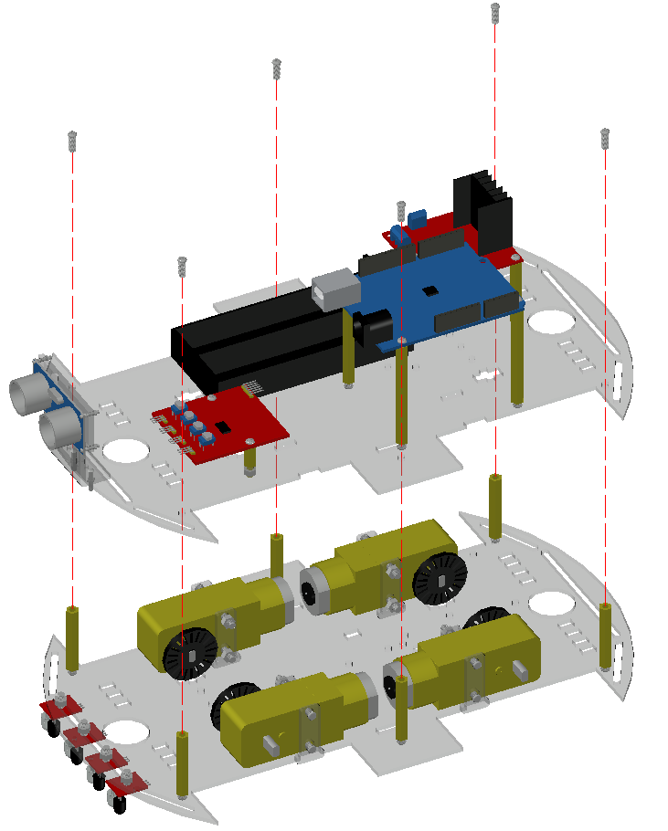
Fix top plate and bottom plate
① M3*8 round head screw*6pcs
Lay the bottom plate flat, place the top plate lightly on the copper column, properly position the holes, screw on the screws, and reinforce with a screwdriver.
Note: pay attention to the orientation of the top and bottom plates.

Slide 17
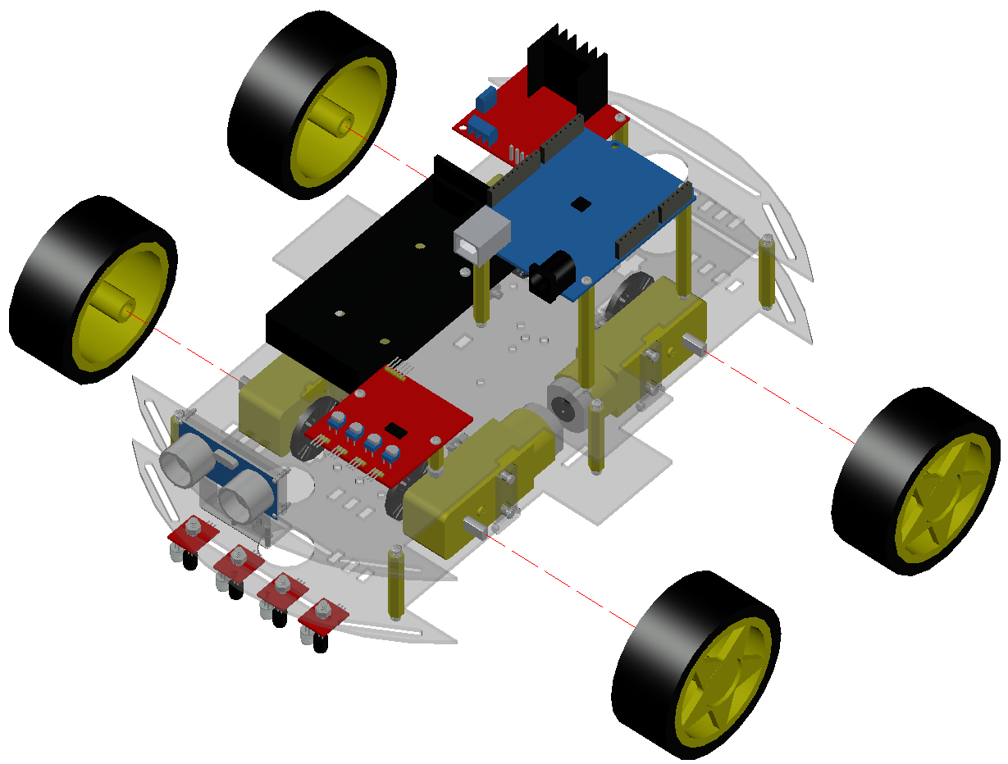
Install the wheel
① wheel*4pcs
Take out the wheel to observe the shape of its hole first, and the shape of the rotating shaft on the motor, and then reinstall the fixed force.

Slide 18
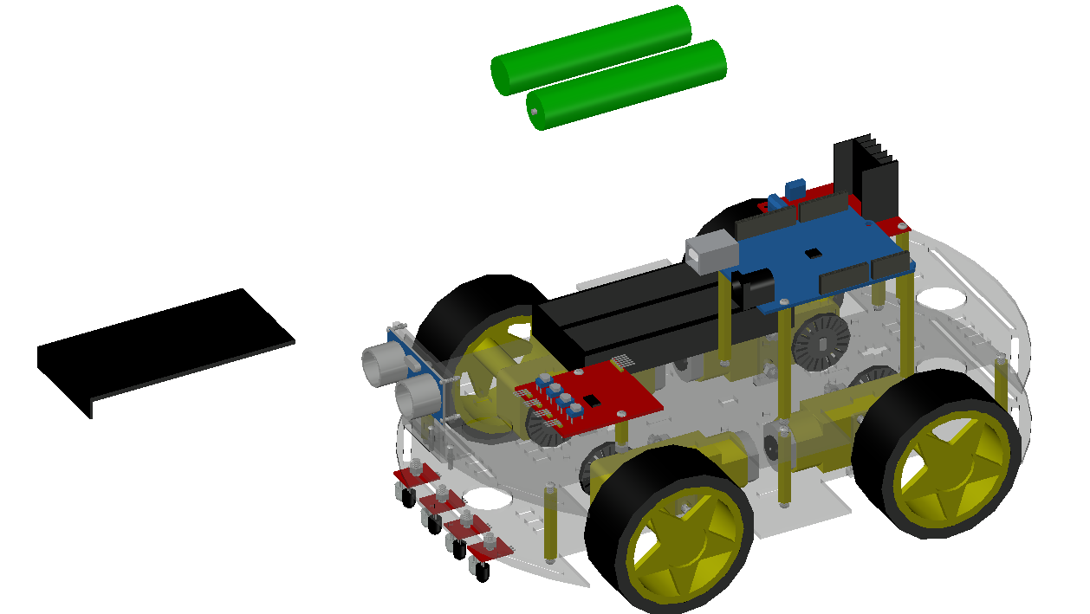
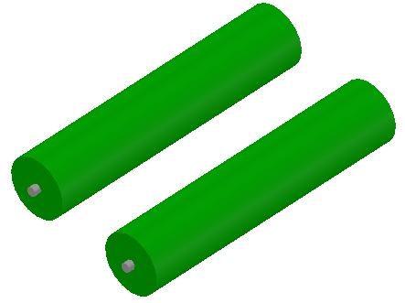
Install the battery and cover the battery
① 18650 Battery*2pcs
② Battery cover*1pc
Put the battery into the battery case first, and then put the battery cover on.
Note: pay attention to the positive and negative poles of the battery, do not install the battery upside down.

Slide 19
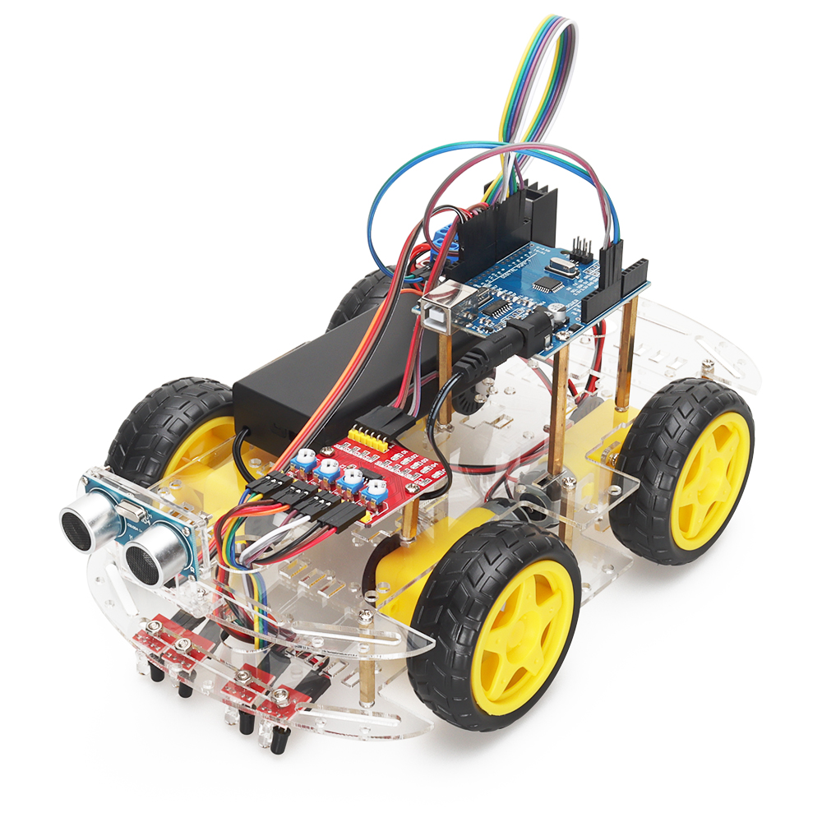
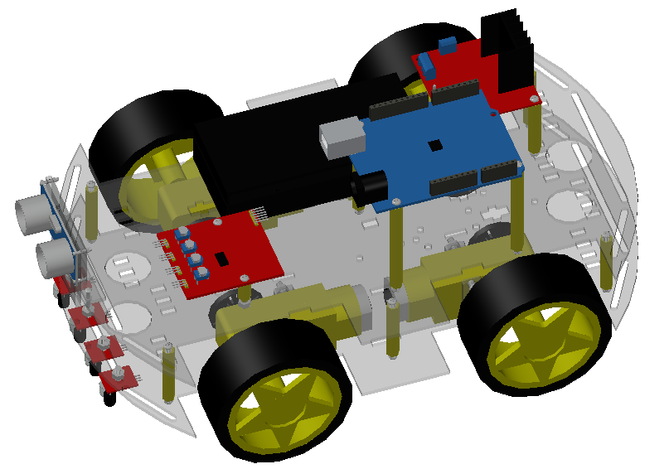
The installation is complete
Here, congratulations you have completed the whole assembly of the car, then you can combine the code to explore the fun of the smart car, enjoy the joy of programming and toy combination.

